Slide 1






Job Recommender System
Alvin Kimathi
Calvin Omwega
Ingavi Kilavuka
Ronny Kabiru
Carol Mundia

Slide 2

Table of contents
Goals and Objectives
Visualizations
01
02
Modelling
Conclusions & Recommendations
03
04

Slide 3

Goals and Objectives
01

Slide 4

Goals and Objectives
Problem Statement:
In the rapidly evolving job market, especially within the data science and analytics field, users are often overwhelmed by the vast number of job opportunities available. Many struggle to find positions that align with their specific skills, experience, and preferences in this specialized domain. The problem is exacerbated by traditional job platforms, which often lack the capability to provide personalized recommendations tailored to the unique demands of data science and analytics roles. This project aims to address this gap by developing a job recommender system that helps users find data science and analytics jobs that closely match their job title or description preferences, thereby increasing the chances of finding a suitable position more quickly.

Slide 5
Objectives
Expand Service Offerings
- Increase Platform Reach
Enhance Job Matching Precision
- Improve User Engagement

Slide 6
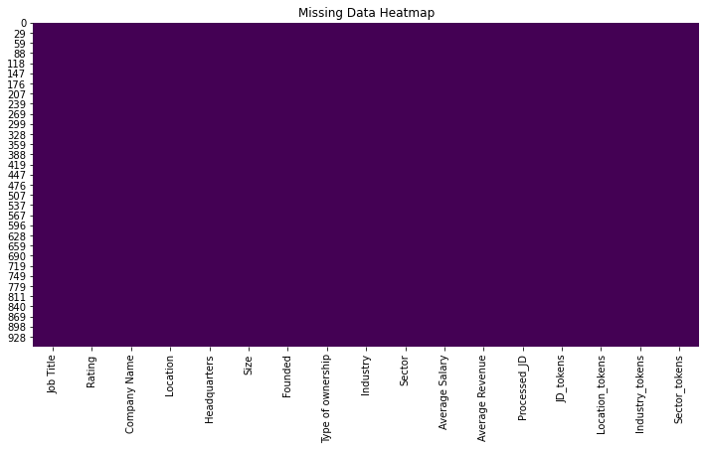
Visualizations

Slide 7
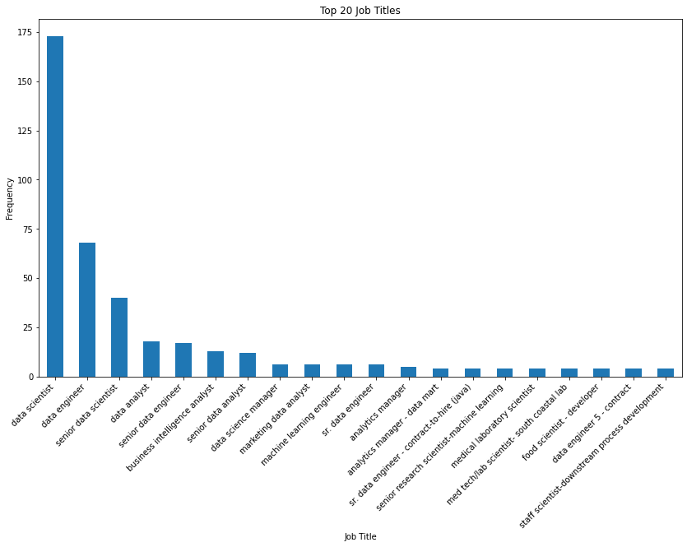

Slide 8
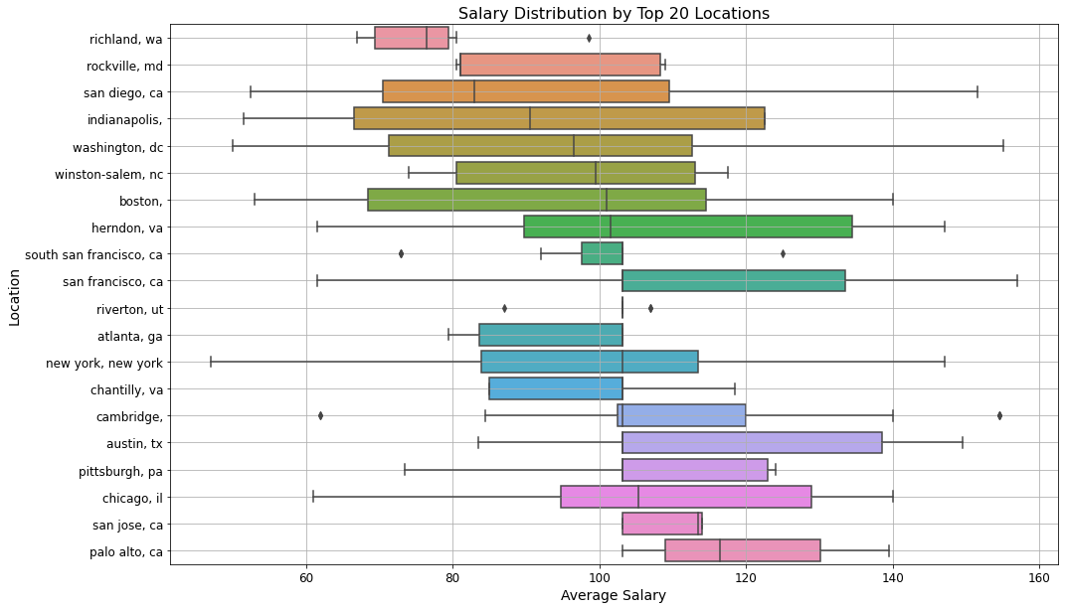


Slide 9
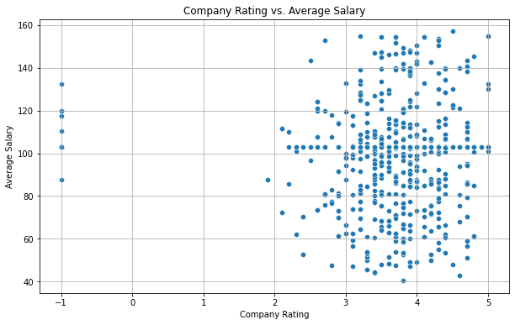

Slide 10
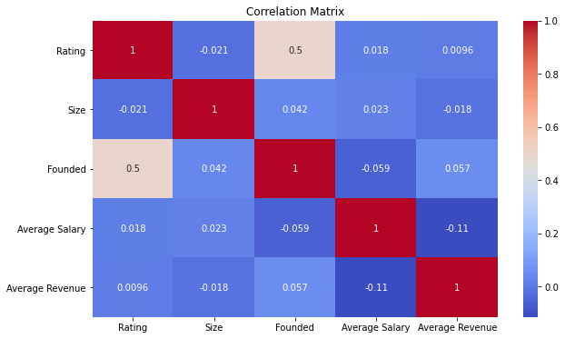

Slide 11
Models
KNN Basic
The KNNBasic algorithm produced an RMSE of 0.9447 and an MAE of 0.5704, indicating decreased consistency and effectiveness. With an accuracy of 84.26%, the model required further tuning.
SVD
The SVD model achieved an RMSE of 0.8443, an MAE of 0.5149, and an accuracy of 89.45%. This improvement makes it the most robust model we've evaluated, so we recommend it as the best choice for our predictive task.
Parameter tuning
Did not as good a result as our SVD model at 85% accuracy

Slide 12
Our recommendation system
Our job recommender system helps users find job postings similar to the job title or description they enter. Here’s how it works:
1. User Input: You provide a job title or description (e.g., "Data Scientist").
2. Text Analysis: The system converts all job postings into numerical data that represents their content.
3. Similarity Matching: It compares your input with these numerical representations to find jobs with similar content.
4. Ranking: The system ranks job postings based on their similarity to your input.
5. Recommendations: It shows you the top job matches along with details like location and salary.
This approach helps personalize job suggestions and ensures you see relevant opportunities based on your interests.

Slide 13
Recommendations
Incorporate User Feedback: Consider implementing a feedback mechanism where users can rate or interact with recommended jobs. This feedback can be used to refine the recommendation system by learning from user preferences over time.
Diversify Filters: Expand the system to allow users to filter job recommendations based on additional criteria such as location, industry, company size, and salary range. This will make the recommendations more personalized and relevant.
Improve Data Quality: Ensure that the job descriptions in the dataset are detailed and comprehensive. High-quality text data leads to better recommendations, as the system relies on text similarity.

Slide 14
Thank you
Any questions??

